Slide 1
Epilepsy, Post traumatic Epilepsy & Sports
Nitin K Sethi, MD, MBBS, FAAN
Associate Professor of Neurology
New York-Presbyterian Hospital
Weill Cornell Medical Center
New York, NY
Director and Chief Coordinator Brain Care Foundation
Diplomate of National Boards (DNB) Internal Medicine (India)
Diplomate American Board of Psychiatry and Neurology (ABPN)
Diplomate American Board of Clinical Neurophysiology (ABCN) with added competency in Central Clinical Neurophysiology, Epilepsy Monitoring, Intraoperative Monitoring
Diplomate American Board of Psychiatry and Neurology (ABPN) with added competency in Epilepsy
Diplomate American Board of Psychiatry and Neurology (ABPN) with added competency in Sleep Medicine
Diplomate American College of Sports Medicine (ACSM)/Association of Ringside Physicians-Certified Ringside Physician

Slide 2
Disclosures:
Associate Editor The Eastern Journal of Medicine
Ringside Physician, New York State Athletic Commission
Unaffiliated Neurotrauma Consultant, National Football League

Slide 3
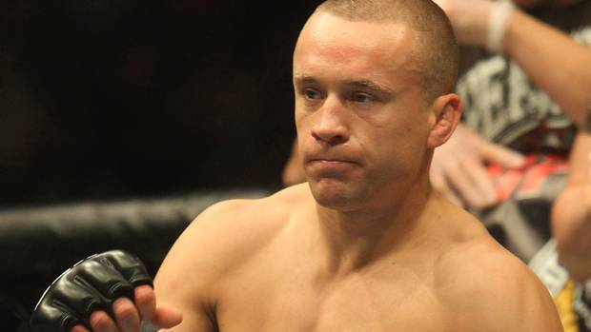
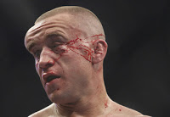
Concussion before and after…

Slide 4
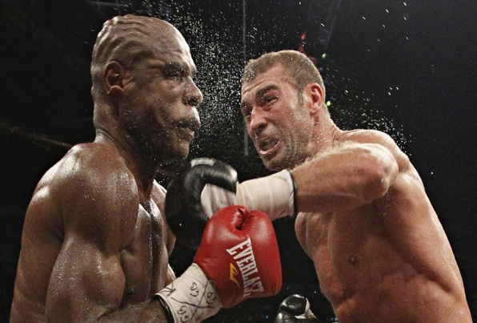
Fundamental questions:
Do repeated or even single bumps and blows to the head sustained during playing sports cause any permanent/ residual damage such as seizures or chronic traumatic encephalopathy (CTE)?
Specially relevant for amateur and professional athletes in contact sports such as boxing, football, soccer, ice-hockey-where blows to the head and concussions are frequent.
Is there a safe upper limit beyond which the damage is permanent or progressive?
What is the permanent damage that is sustained-what symptoms to watch for?
Can it be prevented?
Can it be reversed?
Is there any treatment-preventive and curative?

Slide 5
Where, in whom and how to look for answers to the above questions
Contact sports like boxing, football, MMA and ice hockey where concussions are common and frequent.
Study professional and amateur athletes who take part in these sports.
Study different age groups-pediatric and adult to answer the fundamental question-are pediatric brains and female brains more vulnerable?
How?--MRI, biomarkers-blood/ CSF, autopsy studies.

Slide 6
Sports Related Post Traumatic Seizures
One concern for athletes who play contact sports (boxing, karate, kick-boxing, muay thai boxing, American football, ice-hockey, wrestling, judo) is that of TBI and resultant neurological sequelae such as seizures.
Question-can repeated concussions during some sports potentially cause seizures or exacerbate pre-existing seizures?

Slide 7
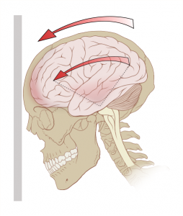
Important questions that need answers
Are these concerns actually based on scientific evidence or are they unfounded?
Can vigorous physical exercise provoke seizures?
Can/does mild TBI sustained while playing contact sports lead to post traumatic seizures/epilepsy?
What about the athlete who suffers from epilepsy? Can indulgence in some sports make seizures potentially worse Vs could some sports actually be beneficial for people with epilepsy (physically and psychologically).
Which sports are safe and which are not?

Slide 8
To answer these questions one may ask why are people with epilepsy restricted from some sports?
First rationale---occurrence of an untimely seizure during sporting event has the potential for causing substantial injury both to the athlete with epilepsy as well as fellow athletes and even spectators.
Second rationale-exercise especially aerobic exercise may exacerbate seizures.
Third rationale--injury sustained while playing sport shall make epilepsy worse.
Examples:
  An athlete with epilepsy has a generalized convulsion or a complex partial seizure while skydiving or while taking part in an automobile racing event making bends at speeds in excess of 100mph
  An athlete with epilepsy suffers a seizure while taking part in a swimming meet.
  An athlete with epilepsy suffers a seizure while bicycling or while horse racing
  An athlete with epilepsy suffers a seizure while skiing down a steep hill or while snowboarding.
  More mundane such as having a seizure while running on a treadmill, while playing tennis, while jogging outside

Slide 9
Exercise and seizures
some studies have shown an increase in interictal discharges during or after exercise (mostly in generalized epilepsies).
Simpson et al. (1989)--three healthy adults who presented with generalized seizures shortly after jogging. Each person had previously been asymptomatic, and each had a normal neurologic examination after the seizure. In all three patients CT revealed small frontal cortical SOLs
Strum et al (2002) reported 2 patients with exercise induced temporal lobe epilepsy. A 16-year-old had consistent precipitation of complex partial seizures with behavioral arrest, automatisms and post ictal confusion usually 5 to 20 minutes after running, playing soccer or tennis. More likely if exercise was strenuous. With reduction in exercise and AED therapy a marked reduction in seizure frequency occurred.
seizures not related to emotional state (meaning the degree of competitiveness).
Simpson RK Jr, Grossman RG. Seizures after jogging. N Engl J Med. 1989;321:835.
Sturm JW, Fedi M, Berkovic SF, Reutens DC. Exercise-induced temporal lobe epilepsy. Neurology. 2002;59:1246-8.

Slide 10
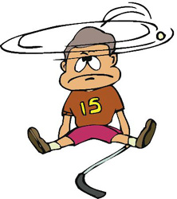
Exercise and seizures-Exercise is BAD--the facts!!!
at least some frontal and temporal lobe seizures are clearly precipitated or at times solely occur during exercise suggesting that these are a form of reflex epilepsies.
a number of physiologic mechanisms by which seizures may be provoked by exercise: hyperventilation with resultant hypocarbia and alkalosis, exercise induced seizures may occur due to hypoglycemia (especially in diabetic patients), physical and psychological stress of competitive sports and potential changes in anti-epileptic drug metabolism.
Exercise is a complex behavior; involves not such the motor system and motor cortex but also other domains such as attention, concentration, vigilance and some limbic networks which mediate motivation, aggression and competitiveness. So possible that patients who have temporal or frontal lobe epilepsy may on rare occasions have seizures triggered by exercise.
Simpson et al (1989)--a seizure after jogging may be an early warning sign of the presence of a underlying cerebral-mass lesion before it has reached a size sufficient to produce mass effect. Exercise lowers the seizure threshold of the epileptogenic cortex surrounding the mass lesion.

Slide 11
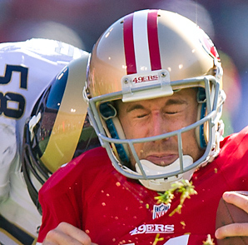
Exercise and seizures-Exercise is GOOD—the facts!!!
limited evidence that exercise may in fact be protective and have physical, physiological and psychological benefits in patients with epilepsy.
EEG studies show that inter-ictal epileptiform discharges either remain unchanged or decrease during exercise so some suggestion that exercise may actually raise the seizure threshold.
animal studies suggest that exercise can modulate neuronal vulnerability to epileptic insults (exercise before a precipitating brain insult demonstrated reduced susceptibility in the kindling model of epilepsy).
increased attention and vigilance during exercise may partially explain the reduced number of seizures in patients with chronic epilepsy who exercise on a regular basis.
regular exercise may influence neuronal and hippocampal plasticity by upregulation of neurotropic factors.
evidence to suggest that regular physical exercise can improve the quality of life, reduce anxiety and depression and improve seizure control in patients with chronic epilepsy.

Slide 12
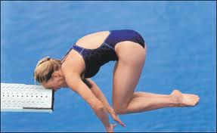
Exercise and seizures-timing and role of EEG in prognostication?
Both during and after exercise.
  usually heavy strenuous exercise precipitates the seizure.
  seizure may occur at the peak of exercise when the heart rate goes up and the patient hyperventilates.
  -----Example: an athlete playing football. Heart rate goes up→hyperventilates→absence seizure/ complex partial seizure-→unable to defend himself from a rough tackle-→serious injury.
Seizures may occur after exercise (due to continued hyperventilation and hypocarbia).
Study from Norway (Epilepsia) 26 children with intractable partial and generalized epilepsy were exercised during video-telemetry recording, aiming at exhaustion after 10 min.
  Results: during the exercise, epileptiform discharges decreased in 20 of 26 children and showed a rebound increase after the exercise.
  five patients had either unchanged or increased epileptiform activity while exercising. These 5 children had experienced frequent clinical seizures during or immediately after exercise in their leisure time.
  So “Exercise-EEG” may be a helpful diagnostic tool to identify patients who are disposed to have exercise-induced seizures.

Slide 13

Concussion and seizures: what is the link?
link between concussion (closed head trauma/ mild TBI) and seizures has been and continues to be closely looked at .
fear of concussions (minor head trauma) making seizures worse is the prime reason why people with epilepsy are discouraged from some sports such as tackle football, ice-hockey, boxing, mixed martial arts and wrestling.
the human skull is quite resilient and the closed head trauma has to be significant for it result in seizures. Usually a concussion which results in prolonged loss of consciousness (>30 minutes) is graded as a significant head trauma.
minor bumps and bruises to the head do not cause seizures, do not increase the risk of future seizures and more importantly do not make chronic epilepsy worse.
seizures may occur immediately following a severe closed head trauma.
immediate post traumatic seizures by definition occur within 24 hours of the injury. They have also been referred to as impact seizures.
early post traumatic epilepsy refers to seizures which occur about a week to 6 months after the injury.
seizures may occur as far out at 2 to 5 years after head trauma (late post traumatic epilepsy).
factors which increase the risk of post traumatic seizures/ epilepsy include severity of trauma, prolonged loss of consciousness (more than 24 hours), penetrating head injury, intra or extraaxial hemorrhage, depressed skull fracture and early post traumatic seizures.

Slide 14
Counseling athletes
Athletes with epilepsy should be encouraged to exercise and take part in sports.
No sport should be completely off limits to them with the exception of maybe sky-diving, river rafting and boxing.
Key is proper supervision and playing sports safely.
Walking, running, cycling and yoga are great exercises with little to no risks.
Advise athletes with epilepsy (especially those with poorly controlled epilepsy) to wear a Medic Alert bracelet or carry a card in their wallet.
Low risk recreational sports such as walking or running usually do not need a 1:1 supervision if seizures well controlled by history.
Team sports such as volleyball, basketball, baseball and softball carry low risk of injury.
For cycling advise to wear a helmet and have bikes fitted with lights and reflectors.
Swimming-many are discouraged from swimming due to an irrational fear of caregivers and physicians of drowning.
  Advise not to swim alone.
  Swim in a pool which has life guards. Swimming in the open seas is more risky.
  Wear a life jacket.

Slide 15
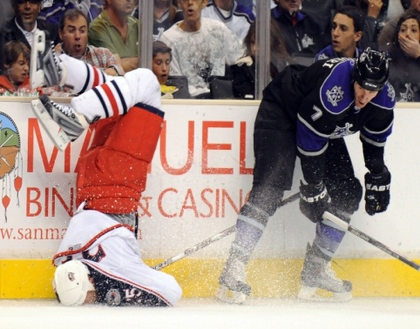
Medical therapies (pharmacological and non-pharmacological) for concussion
  . Physical and Cognitive Rest
  . Medications-symptomatic treatments for
    -post concussion headaches: amitriptyline (Elavil), beta blockers, CCBs, valproic acid, triptans, dihydroergotamine, gabapentin, avoid excessive OTC NSAIDs, nonpharmacological: biofeedback, physical therapy, psychotherapy, trigger point injections.
    -sleep disturbance: improve sleep hygiene, melatonin, Trazodone, avoid benzodiazepines (GABA agonists)
    -emotional and behavioral disturbances: tricyclic antidepressants, SSRIs-such as sertraline.
    -Cognitive disturbances (difficulty with memory, concentration, slowed processing): cognitive rehab, methylphenidate, amantadine, donepezil, rivastigmine, fluoxetine, bromocriptine.

Slide 16
Amantadine: does it work?
Dopaminergic agent with NMDA antagonist effects
Conflicting results from studies in TBI patients
Empirical support as effective in certain concussion related cognitive deficits (attention, concentration, processing time, psychomotor speed, fatigue, agitation) especially in pediatric and adolescent athletes
Other studies show no benefit
Safety is well established
May benefit athletes who experience a protracted recovery (>3 weeks).
Reddy CC et al. J Head Trauma Rehabil 2012

