Slide 1
Boxer safety and the relationship between the referee and the ringside physician
Nitin K Sethi, MD, MBBS, FAAN
Assistant Professor of Neurology
New York-Presbyterian Hospital
Weill Cornell Medical Center
Director and Chief Coordinator Brain Care Foundation
Diplomate of National Board (DNB) Internal Medicine (India)
Diplomate American Board of Psychiatry and Neurology (ABPN)
Diplomate American Board of Clinical Neurophysiology (ABCN) added competency in Central Clinical Neurophysiology, Epilepsy Monitoring, Intraoperative Monitoring
Diplomate American Board of Psychiatry and Neurology (ABPN) added competency in Epilepsy
Diplomate American Board of Psychiatry and Neurology(ABPN) added competency in Sleep Medicine
Diplomate American Board of Sports Medicine (ABSM) Certified Ringside Physician
Member The Association of Ringside Physicians (ARP)

Slide 2
The fight must go on….
Everyone ringside wants the fight to go on
  the two boxers and their corners-sometimes not always!
  the promoter-always!
  the media-always!
  the spectators-always!
  the commission and its appointed officials-only if both the boxers meet the commission requirements!
  the referee-only if the boxers are fighting a fair fight and able to defend themselves!
  the judges-usually do not interfere with the conduct of the fight!
  the ringside physicians-only if the boxers are medically fit before, during and immediately after the contest!

Slide 3
So we all want the fight to go on…but…
Some more than other?-promoter, media, spectators
Threshold to stop a fight (enough is enough!!!) may vary based on-
  Knowledge of boxing-rules and regulations
  Knowledge of the boxers-fitness level, pre-existing medical conditions, pre-bout fitness, intra-bout fitness
  Knowledge of medicine and bout ending injuries-head injuries, orthopedic injuries, eye injuries, blunt abdominal trauma

Slide 4
So who should be authorized to stop a fight?
Someone who has knowledge of boxing (rules and regulations) as well as medicine (traumatic brain injury, orthopedic and eye-injuries)
Someone who is close to the action/ in the midst of the action
  Either Referee alone or Referee as well as the Ringside Physician
Uniform Boxing Rules (approved August 25, 2001, Amended August 2, 2002, Amended July 3, 2008): referee is the sole arbiter of a bout and is the only individual authorized to stop a contest.
Unified rules of MMA and in NYS: referee and ringside physician are the sole arbiters of a fight and are the only individuals authorized to enter the fighting area at any time during competition and authorized to stop a fight.

Slide 5
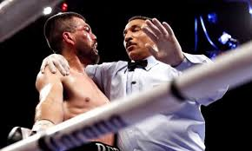
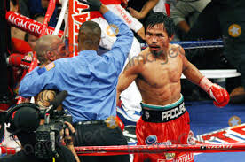
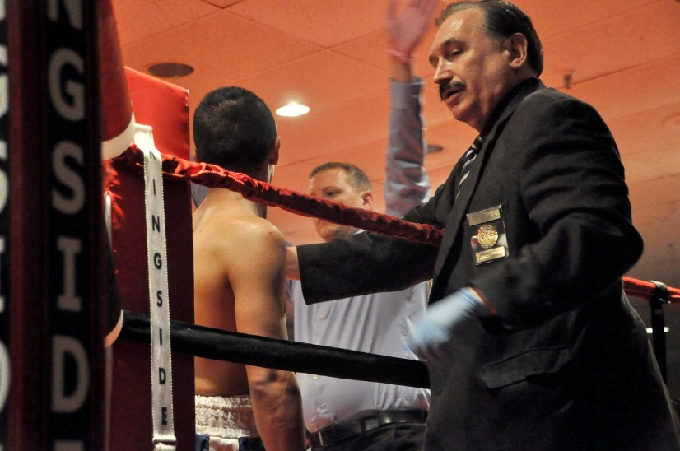
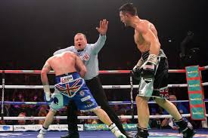
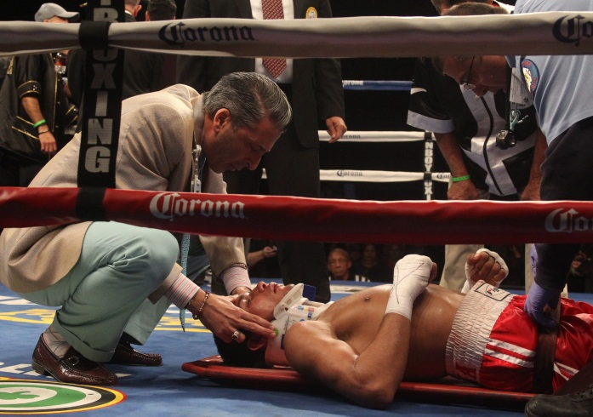
So who should be authorized to stop a fight?

Slide 6
The other MORE important question…
WHEN should the fight be stopped!
  If stopped prematurely-unfair to the boxers, their corners, the promoter and the public
  If stopped too late-risk of serious injury even death of the boxer
  BOXERS SAFETY SHOULD PRECEDE ALL OTHER CONSIDERATIONS

Slide 7
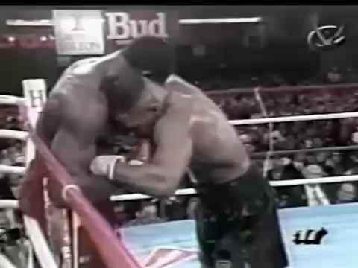
Good or bad stoppage?

Slide 8
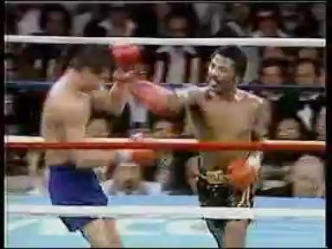
Good or bad stoppage?

Slide 9
We are all under scrutiny
As Injuries Mount, Boxing Looks Within
By JOHN ELIGON Published: September 24, 2005 The New York Times
Beaten Into Action: A Perspective on Blood Sports
“The medical, and especially the neurology, community has an obligation to do more. We need to spread the word that brain bashing is not a socially acceptable spectator sport, and partner with our national organizations to expand and improve the effectiveness of public awareness and other educational initiatives.
We should forcefully counter articles in the medical literature taking the position that closer medical supervision could obviate the need for a ban, or even worse that consenting adults have the ethical right to maim each other if they choose to do so.
Finally, we should avoid the temptation to align with groups whose purpose is anathema to our mission, no matter how great our financial need.”
Hauser SL. Beaten into action: a perspective on blood sports. Ann Neurol 2012;72:A4–A5.)

Slide 10
Boxers safety precedes all other considerations
Ideally everyone would like the bout to be stopped before a life threating injury or career ending injury occurs.
Key word is before NOT after
Most of the times that is not possible-so more realistic goal should be timely identification of a serious injury in the ring and timely stoppage of fight.
For that to occur-referee should be aware of the signs and symptoms of serious injuries.
Since referee’s medical knowledge is limited, he and ringside doctor need to act as a team.

Slide 11
Boxers safety-what the referee needs to know
Causes of sudden death in the ring: usually cardiac or neurological
Cardiac causes: most commonly picked up by the ringside physician prior to the boxer entering the ring. Red flags in the ring-sudden hard blow to the sternum, boxer complains of chest pain, shortness of breath.
Neurological causes: tough to determine clinically.

Slide 12
Neurological causes of sudden death
Bleeding into the various compartments of the brain leading to increase in intracranial pressure, pressure on brainstem (we call this herniation) and death or permanent neurological disability.

Slide 13
Acute Neurological Injuries in Boxing:
Traumatic amnesia—retrograde and anterograde
Groggy state ? Post concussion syndrome
Subdural hematoma (SDH): major cause of boxing-related mortality
Epidural hematoma (EDH)
Subarachnoid hemorrhage (SAH)
Intracranial hemorrhage
Diffuse brain contusions without associated hemorrhages
Diffuse axonal injuries (DAI)
Dissection-vertebral artery/ carotid artery

Slide 14
Chronic Neurological Injuries in Boxing
Chronic Traumatic Encephalopathy (CTE)/ Punch Drunk Syndrome/ Dementia Pugilistica/ Cuckoo/ Goofy/ Cutting paper dolls/ Slug nutty

Slide 15
Concussions in Boxing
Different grades/ severity
  Grade 1 (mild) knockout: "out on the feet”-unable to defend himself, looks dazed, may stagger around the ring or rests on the rope.
  Grade 2 (mild) knockout: boxer is knocked down and cannot rise before the count of ten, but does not experience loss of consciousness.
  Grade 3 (moderate) knockout: boxer is rendered unconscious but recovers quickly.
  Grade 4 (severe) knockout: similar to grade 3, except the period of unconsciousness is longer.

Slide 16
Common clinical manifestations (the groggy state):
Headache—unlikely that the boxer shall report it, but if he does-stop the fight
Dizziness
Imbalance-staggers to his corner
Irritability
Fatigue
Poor memory
Dysarthria that usually passes-boxer returns to baseline
Confused-does not remember the round, walks to the wrong corner after the bell, hits out at the referee

Slide 17
Biomechanics of boxing concussions
Concussive properties of a boxer's punch is related to the manner in which the punch is delivered and how the mechanical forces are transferred and absorbed through the intracranial cavity.
Blows thrown from the shoulder, such as the roundhouse or hook, tend to deliver more force than the straight forward jab.
The force transmitted by a punch is directly proportional to the mass of the glove and the velocity of the swing, and is inversely proportional to the total mass opposing the punch.
The essential feature of a concussive force is that the force is sufficient enough to accelerate the skull. Rotational (angular) acceleration, linear (translational) acceleration, and impact deceleration can all play a role in the develop ment of acute cerebral injury.
Angular acceleration occurs when a punch causes a rotational movement of the skull that can potentially stretch and tear cerebral blood vessels.
Linear acceleration occurs from blows directly to the face in an anterior to posterior direction, which may result in gliding contusions.
Rotational acceleration more commonly induces a concussion and often causes diffuse brain injury.
Force produced by a blow is usually some variable combination of linear and rotational acceleration.
Contact phenomena described as the local mechanical damage to the cerebrum secondary to the impact of a blow, is also an important determinant of brain injury and/or skull fracture.
In boxing, rarely is the impact of a blow sufficient to produce a skull fracture; however, focal contusions remain a real possibility.
Once a boxer is knocked down and strikes the cranium on the floor mat, a rapid deceleration (impact deceleration) occurs that can result in contrecoup contusions.

Slide 18
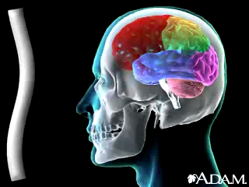
Anatomy of a concussion

Slide 19

Anatomy of a concussion

Slide 20

Anatomy of a concussion

Slide 21
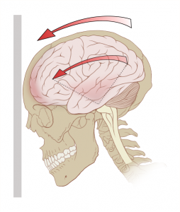
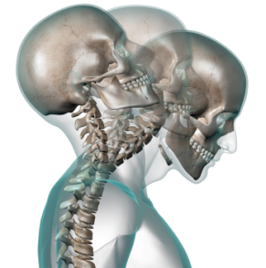
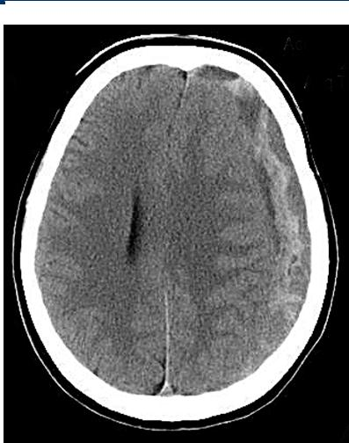
Acute Neurological Injury in Boxers

Slide 22
Every referee should know
Modified Maddocks questions, preceded with the preface: "I am going to ask you a few questions, listen carefully and give your best effort"
At what venue are you today?
Which round is it now?
Who are you fighting?
How many rounds is the fight?
Did you win or lose the last fight?

Slide 23
Advantages of using the Maddocks questions:
Easy to administer
Quick assessment of concussion in the ring
If boxer’s answers incorrectly bring it to the attention of ringside doctor.
If administered by ringside physician in between rounds and boxer answers incorrectly bring it to the attention of the referee.
This boxer needs further assessment to determine whether he can safely continue.

Slide 24
Every referee should now
Significance of gait and balance assessment of boxer: tandem walking, Balance Error Scoring System (BESS): double leg, single leg and tandem stance
  Quick to administer
  In the ring by the ringside physician. Communicate results to the referee if the fight is allowed to continue.
  If positive, boxer needs close observation by both referee and ringside physician

Slide 25
Every referee should know
Eye injuries which warrant a bout to be stopped-lacerations (location is more important that depth and amount of bleeding), retinal detachment
Facial injuries-lacerations involving the supraorbital, infraorbital areas
Chest injuries-fractures of the rib-pneumothorax
Abdominal trauma-splenic laceration, hepatic laceration, renal contusion
Basic injuries involving the hands, wrists, shoulder and knees

Slide 26
Stopping a fight on medical grounds
Ideally by the referee after consulting with the ringside physician.
After taking into account not just that round but the previous rounds too—how many head blows has the boxer sustained?
After taking into account the boxer’s and his corners body language
If during the round the ringside doctor notices something which the referee does not or wants the fight stopped-signal to the referee. Referee can start and stop round and bring the boxer over to the doctor for assessment.
Good and constant communication between referee and ringside physician is the key. Talk in between the rounds. Share your assessment of the boxer with each other. Share your concern about the boxer with each other. That way you shall know the comfort threshold of each other.

Slide 27
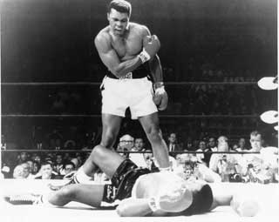
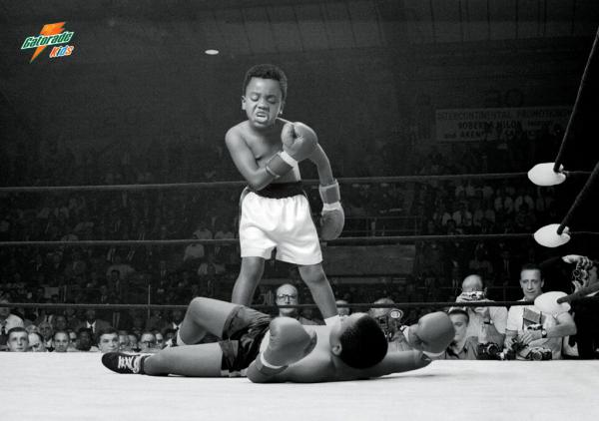
Boxing-Brutal or Brilliant?-The Sweet Science
  "Float like a butterfly, sting like a bee.“
  "When you are as great as I am, it is hard to be humble.“
  Muhammad Ali

Slide 28
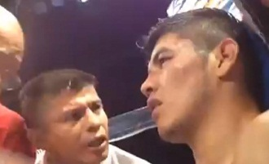
Some sobering facts: Boxing is a dangerous sport and boxers die
Mexican featherweight boxer Oscar ‘El Fantasma’ Gonzalez died February 3rd 2014 from brain injuries sustained during a match with Jesus Galicia in Mexico City. Gonzalez was knocked unconscious during the 10th round, and medical staff immediately sought to get him on an oxygen ventilator. Within 36 hours, the boxer was pulled off a respirator at his wife’s request, after doctors had declared that parts of his brain had died. He was 23 years old.
Junior featherweight boxer Francisco “Frankie” Leal of Mexico died from severe head trauma incurred while being knocked out by opponent Raul Hirales. Leal had already nearly died in the ring 18 months earlier, when he had to be rushed to a hospital for head injuries after a knockout loss to Russian boxer Evgeny Gradovich. This did not prevent boxing authorities from allowing Leal to get back into the ring. He was 26 and left behind a wife and son.

Slide 29
Oscar Gonzalez Mexican Boxer Dies by knockout in his fight with Jesus Galicia

Slide 30
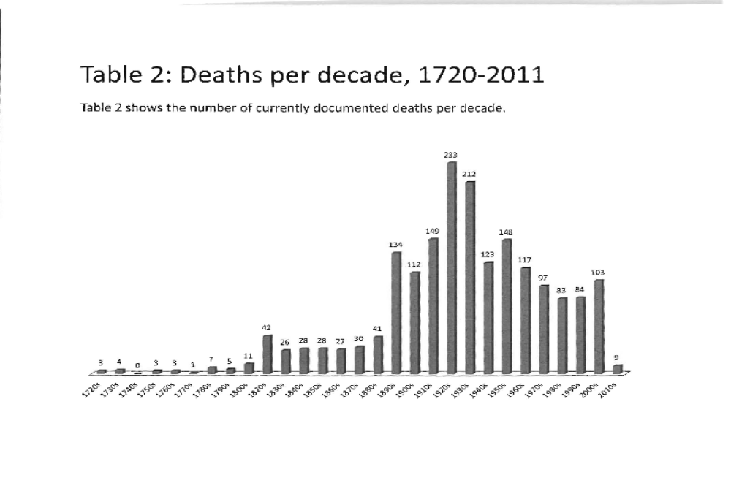
THE MANUEL VELAZQUEZ COLLECTION OF BOXING FATALITIES

Slide 31
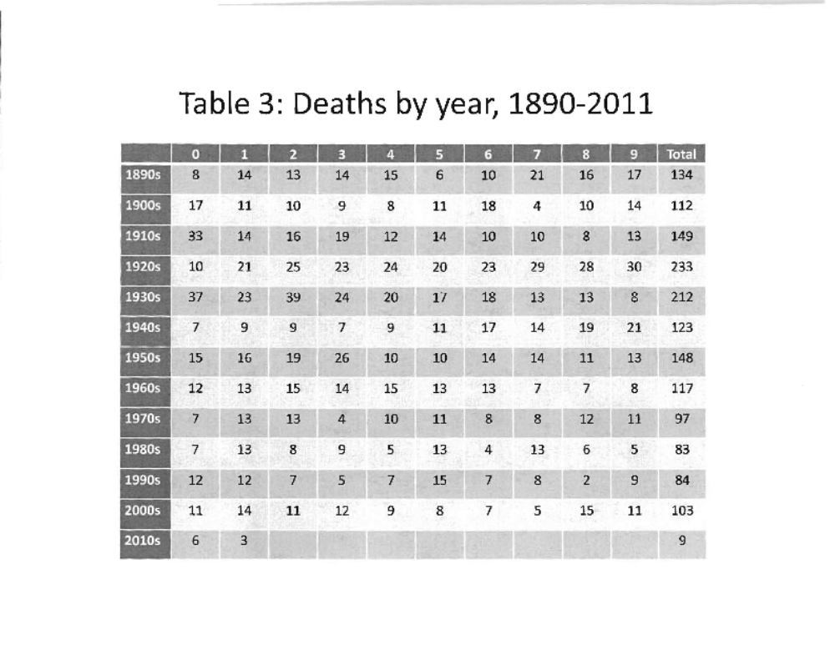
THE MANUEL VELAZQUEZ COLLECTION OF BOXING FATALITIES

Slide 32
Share the responsibility of stopping a fight with each other
Compliment each others knowledge of boxing, medicine and the boxers.
Share the pressure of the fight with each other.
Share the blame of a bad stoppage with each other.
Share the praise of a good stoppage with each other.
Always put the boxers safety first.

Slide 33
Thank you
“I gave you your instructions in the dressing room. Remember protect yourself at all times and above all obey my command at all times.
Touch Em up. Good luck!!!”

